Slide 1
Hello welcome to my presentation
Done by Tony. K

Slide 2
My favorite things to do
Play games: like call of duity, fortnit and so many others
Cars: I love cars like – the Bugatti my favorite car in the world
Watching movies – like teen wolf, arrow etc..
Listening to music: I like hip hop, R&B, and others

Slide 3





Games: here r some of the games I like

Slide 4
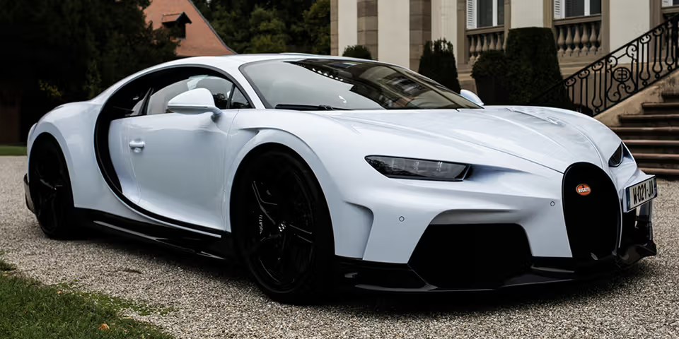

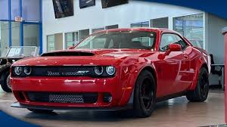
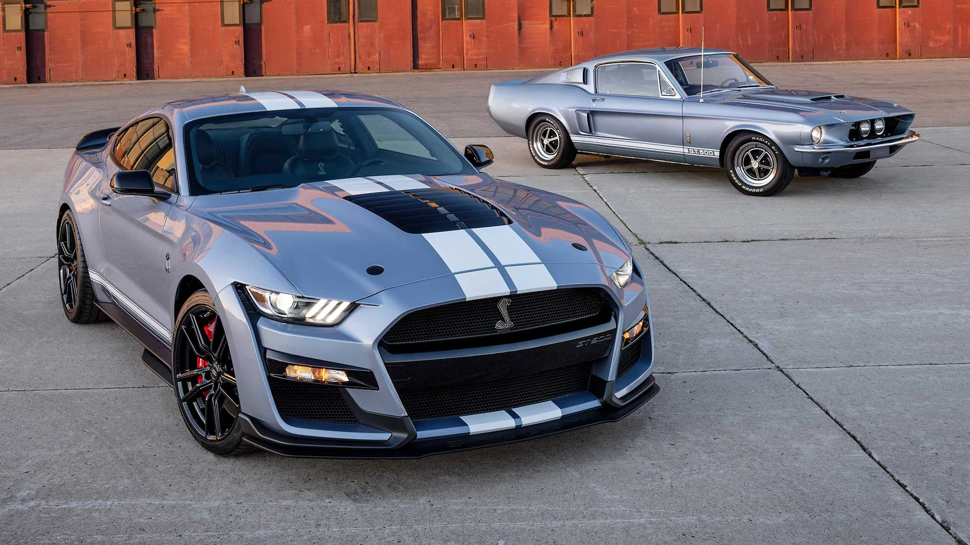
Cars: the type of cars I like
The Bugatti –
The Dodge –
The ford mustang –
and so so many others.

Slide 5
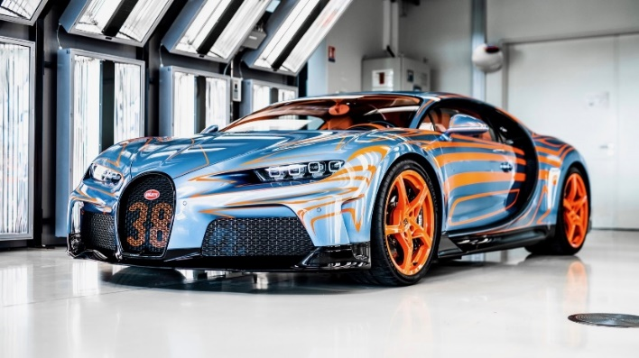
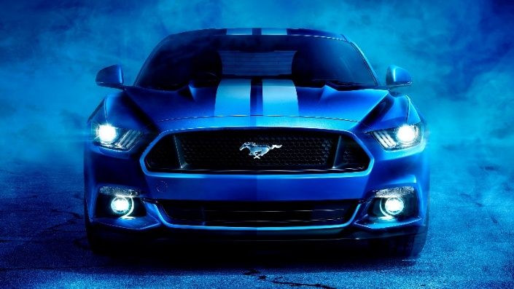
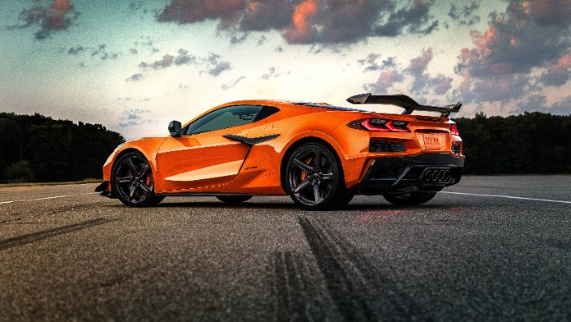
Some of the prices:
The Bugatti
The ford mustang
The corvette
It’s prices range from $1.9 Million to $12 Million and above
It’s prices range is raffle about $30,000 to $60,000 and above
It’s prices range is raffle about $80,000 to $150,000 and above

Slide 6




Movies: when I get lazy of work
teen wolf
The green arrow
The witcher
And many more.

Slide 7

Music: when am alone at home
I listen to all kinds of music
R&B
Hip hop
Country
Jazz
2000’s hits
Bass music
soft rock
And so many more.

Slide 8
Thanks for watching
P.S.
I enjoy food and eating
Sleep for long time
And playing sports
If you with to know more you can meet me outside classes ☺

